Slide 1
Combining Forces and Free Body Diagrams
Section 5.6

Slide 2
Combining Forces
Forces in the same direction are added together
Force in the opposite direction are subtracted
Net Force
Overall force acting on an object

Slide 3
Balanced vs. Unbalanced Forces
Balanced
Combine to produce a net force of zero
No change in the object’s motion
Unbalanced
Net force equals the size of the larger force minus the size of the smaller force
Net force does not equal zero
Causes an object to accelerate

Slide 4
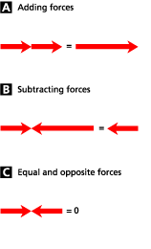

Slide 5
Free-Body Diagram
A picture of a problem representing the object as a particle (or box) and showing all the forces acting on the object.

Slide 6
Steps to Drawing a Free-Body Diagram
Identify all forces acting on the object
Draw a coordinate system
Represent the object as a dot or box at the origin
Draw and label vectors representing each of the forces
Draw and label the net force vector F_{net}

